Slide 1
FSAD – CS 04
Course : – REST Api – Module 04

Slide 2
Agenda - DEMOS
1) REST Api – CRUD – SpringBoot – SpringDataJPA – Post REST WebServices Intro
2) Swagger
3) Recap – React Sending Request to RESTAPI
4) Web Hook – Basic
5) WebSocket – Basic

Slide 3
Web Services
Web Services are basically Implementation of Service Oriented Architecture Style - SOA
SOA – Promotes Service based Apps returning Resources to Clients using simple Protocol such as Http through end-points.
But also promotes Interoperability hence Web Services are 100% Interoperable

Slide 4
Web Services
SOAP
Simple Object Access Protocol
Complex with WSDL & WSML
REST
Uses Plain Http
Stateless
Exchange through XML
Uses Modified Http
Exchange through JSON / XML
REST itself is an Architectural style implementing parent Style SOA

Slide 5
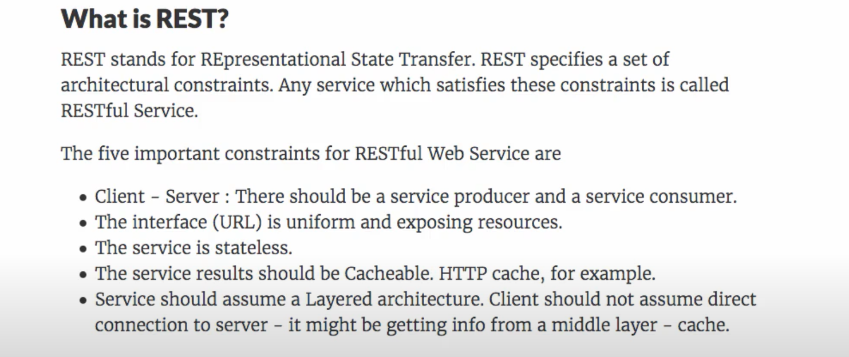
What is REST?

Slide 6
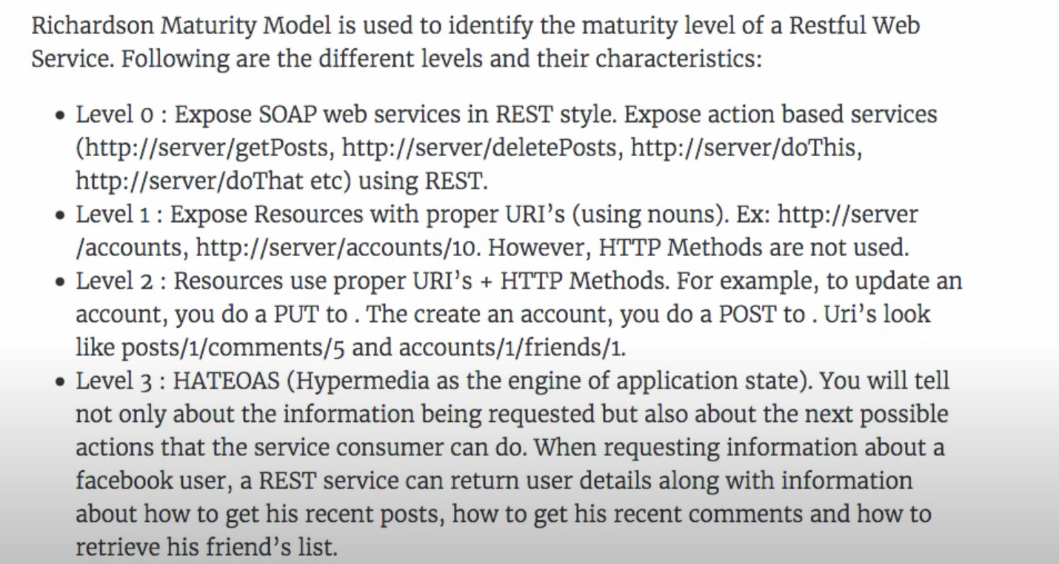
Maturity Model

Slide 7
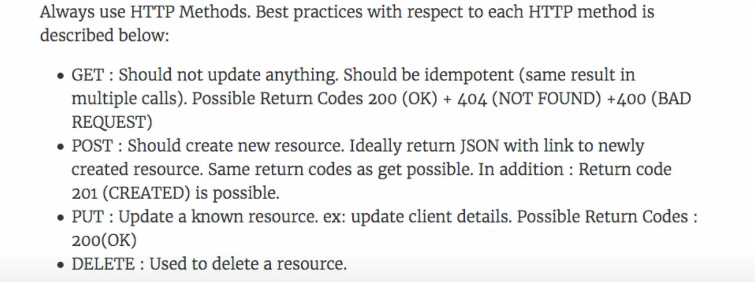
Http Methods

Slide 8
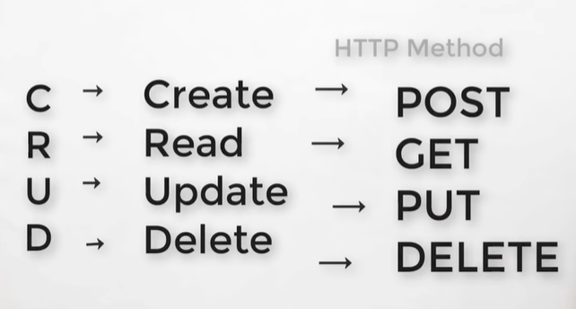
Http Methods

Slide 9
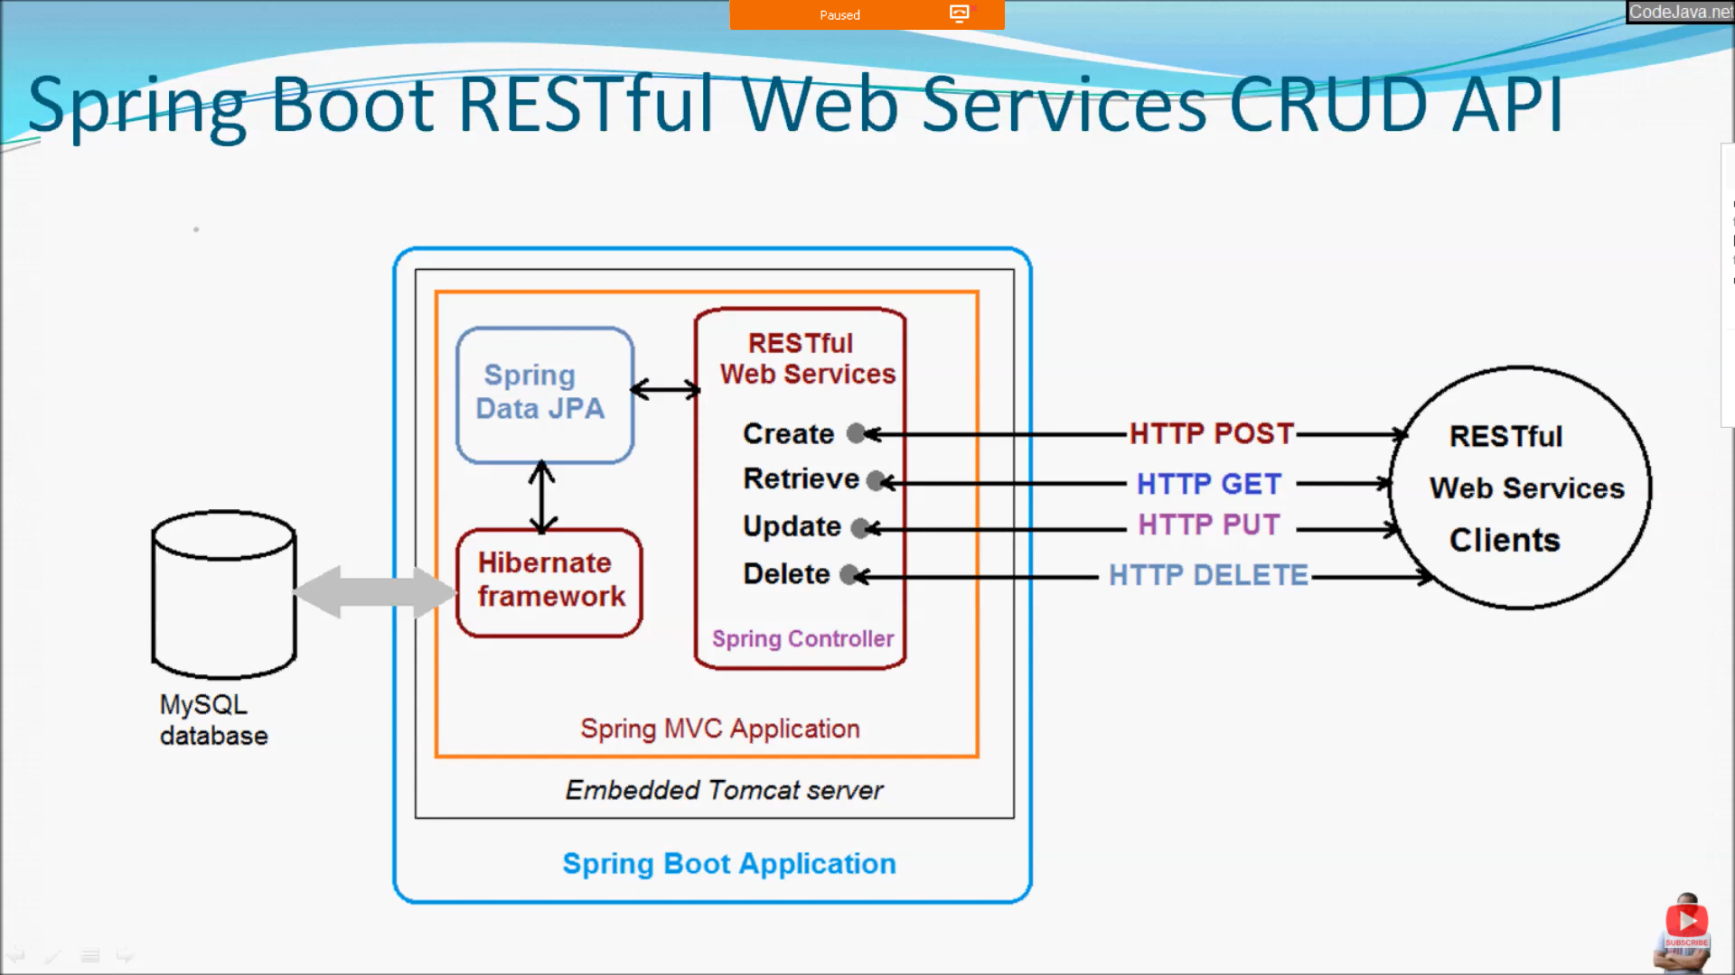
SpringBoot RESTful Web Services

Slide 10
Thank You

